Slide 1
VR Design Specifics
Set 6

Slide 2
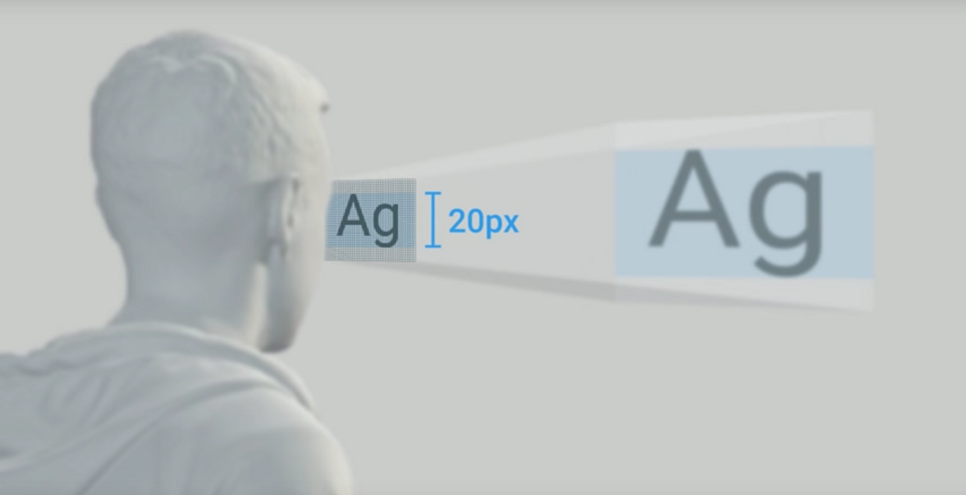
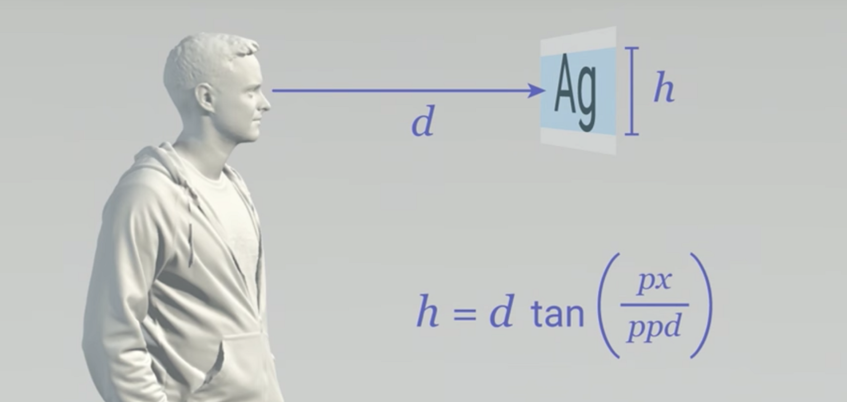
VR Design Specifics: UI: Text in VR Patrick O'Luanaigh (nDreams), Mike Alger, (Google)
User presence as an issue related to informing the player
Textual interfaces are an intrusion
Text will never completely go away
Put it only where it’s really needed
Resolution is a major constraint
Leads to aliasing with hard edges
Anti-aliasing helps but impacts performance
Avoid hard edges and thin lines
Text Resolution is impacted
Larger is better
Avoid showing text on white and translucent backgrounds.
Current HMDs are about 13 PPD (pixels per degree)
Text should be ~1.5° degrees tall
Or roughly 20px tall on most current displays
It should be >1.3 meters from the user
Alger
Alger

Slide 3
VR Design Specifics: UI, where does it belong Patrick O'Luanaigh (nDreams)
Minimal is best
Diegetic methods work best for VR
User presence as an issue related to informing the player
Textual interfaces are an intrusion
Text will never completely go away
Put it only where it’s really needed
If you need interface in the Content Area
Consider the Peripheral Zone
Better would be an on-arm or on controller interface
Gaze interface is interested

Slide 4
VR Design Specifics: UI, where does it belong Patrick O'Luanaigh (nDreams)
Minimal is best
Diegetic methods work best for VR
If you need interface in the Content Area
Consider the Peripheral Zone
Better would be an on-arm or on controller interface
Gaze based interface is interested

Slide 5
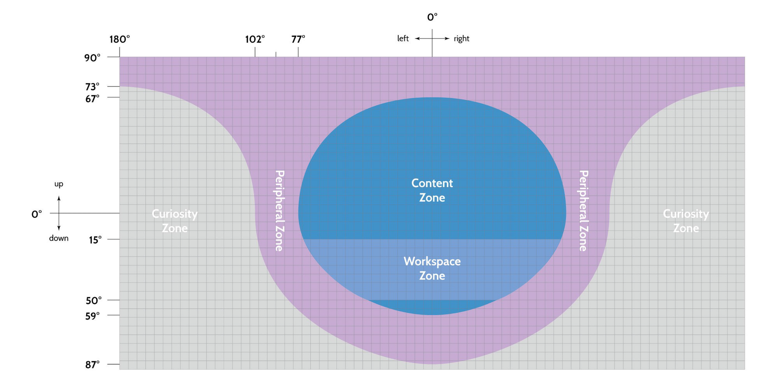
VR Design Specifics: UI, examples: UI in the content zone (Mike Alger)

Slide 6
VR Design Specifics: Interesting UI examples and widgets
Menu location (Cosmic Trip)

Slide 7
VR Design Specifics: UI, examples: Gaze Based (Disney)
We can track the head position
Ray cast and provide feedback as to cursor position
Remember user gaze often returns to the center
Move follow on menu choices off center
Feedback, for everything (hover, choose, chosen)
Cursor flash
Color change
Menu item color change (selected)

Slide 8
VR Design Specifics: UI Examples
Collection of interesting VR UI and UX elements
http://www.xr.design/tags/ui

Slide 9
VR Design Specifics
Movement Methods:
Generally movement shouldn’t be at the speed humans normally walk
Faster or slower is better
No acceleration
Don’t allow normal turning (like in a first person game)
Teleportation
Avoid changing orientation
Avoid acceleration while teleporting
Use frames of reference to anchor the destination (appropriate scale changes to objects)
Tunneling
Masking/removing the peripheral elements can help
https://www.youtube.com/watch?time_continue=31&v=9fgkpM6211w

Slide 10
VR Design Specifics: Teleportation movement
Collection of movement methods
Dash
Blindered
Teleportation
Gaze
Directed
Restricted Directed
Turning methods
Drag
Snap
http://www.xr.design/tags/ui

Slide 11
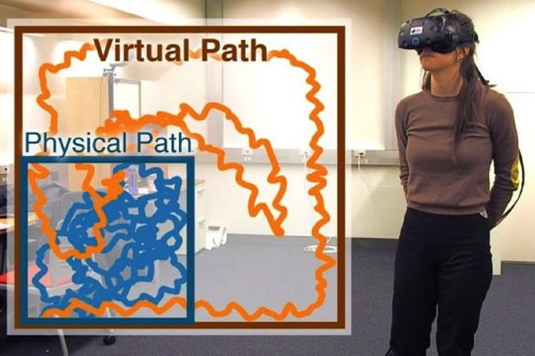
VR Design Specifics: Tracking Saccades will change room play
Saccades refer to the rapid eye movements that occur as you scan a room.
Stony Brook University, Nvidia, and Adobe figure out a way to redirect the VR world as your saccades were occurring.
This allows perceived movement across a large space that occurs in a much smaller space.
This eliminates the simulation sickness often caused by movement.

Slide 12
VR Design: Project Review and Critique
Barrier: https://www.youtube.com/watch?time_continue=159&v=2Top9QH3UzU
Pool Simulator: https://www.youtube.com/watch?v=MDd6dR9YIj8
Harry Potter: https://www.youtube.com/watch?v=dhyCtkrIceI
101010: https://www.youtube.com/watch?v=fLp_2v8y4jg
Auto Industry Hazards: https://www.youtube.com/watch?time_continue=2&v=kHMCKNUGGSg
Spellcasting: https://www.youtube.com/watch?time_continue=9&v=N6JEAUjXeQI
Object Avoidance: https://www.youtube.com/watch?v=KodswdrBYVk
Naruto Simulator: https://www.youtube.com/watch?v=4y4WobB-b90
Factory Simulator: https://www.youtube.com/watch?v=Cr3wc1tDLP8

